Slide 1

Image Emotion Recognition using Region-based Multi-level Features
Tianrong Rao
GBDTC, FEIT, University of Technology, Sydney

Slide 2
Outline
Introduction
Literature review
Methods and experiments
Conclusion and future work

Slide 3
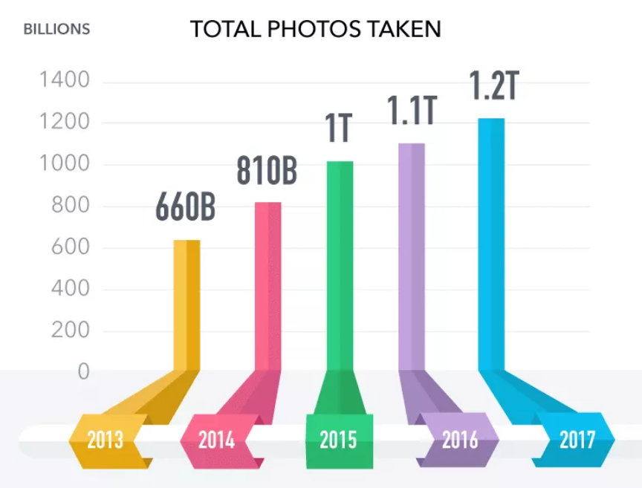
Introduction
Analyzing and understanding image
Huge amount of images are created everyday
Notes:
Just on 5 popular social networks. Not contain 680 million Chinese internet users. For website owner, manage the images. For internet users, quickly find photos they are interested in

Slide 4
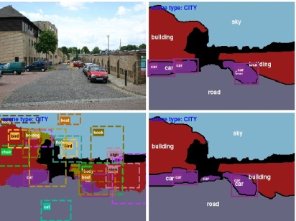
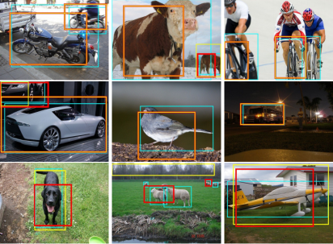
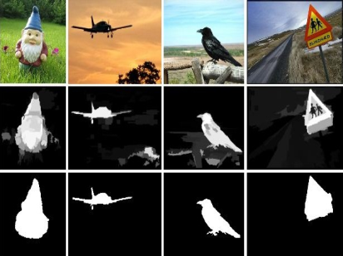
Introduction
Methods of analyzing and understanding image
Semantic-level image analysis
Scene detection
Object detection
Saliency detection
Notes:
Recent research focus on semantic-level image analysis. Popular direction for image processing. Generally use shape, line to describe what’s contain in an image.

Slide 5
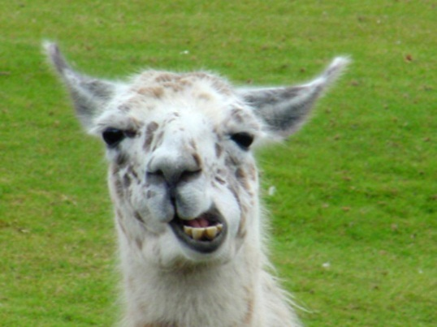
Introduction
Challenges
contentment
Multiple emotional regions
Complexity
amusement
Low-level (Color)
Complexity
Mid-level (Composition)
Multi-level features
High-level
(image semantic)

Slide 6



Introduction
Challenges
Amusement
Excitement
Subjectivity
Amusement
Excitement
Subjectivity
Contentment
Emotional label with probability

Slide 7
Introduction
Goals
Building a framework to analysis image emotion using visual features from high-level to low-level for both global and local views (for complexity)
Consider the uncertainty of emotional labels existing in affective image datasets (for subjectivity)

Slide 8
Outline
Introduction
Literature review
Methods and experiments
Conclusion and future work

Slide 9
Literature review
Emotion representation
Categorical emotion states
Dimensional emotion space
Basic emotions
Coordinate system
Usually 4-14 emotion categories
Amusement, Anger, Awe, Contentment, Disgust, Excitement, Fear, Sad
2-D valence-arousal emotion space
3-D valence-arousal-dominance space
Notes:
In CES models, emotions are represented discretely. Computational results are mapped directly to one of a few basic categories. DES models are continuous emotional representation models. In DES models, emotions are represented in a n-dimensional space. The valence scale ranges the affective responses from positive state to negative state, while the arousal scale ranges the responses from excited to the calm, dominance scale ranges the responses form submissive to dominant. DES models provide a predictable and flexible description for emotions, while CES models in emotion classification is easier for users to understand and label.

Slide 10
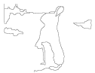
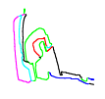
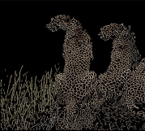

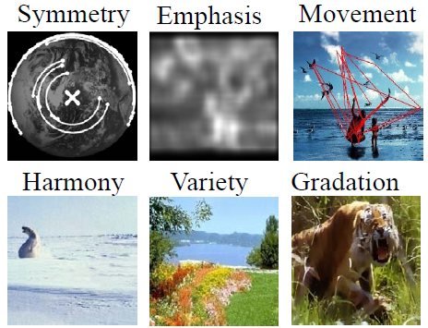
Literature review
Multi-level features for affective image analysis
shape
line
Low-level features (mainly based on art theory)
texture
color
Mid-level features (mainly based on psychology)
Notes:
The existing methods mainly use two kinds of features. low-level features, element-of-art, such as saturation, brightness, colorfulness, color name, coarseness, contrast. Features based on theoretical and empirical concepts from psychology with art theory that are specific for affective analysis

Slide 11
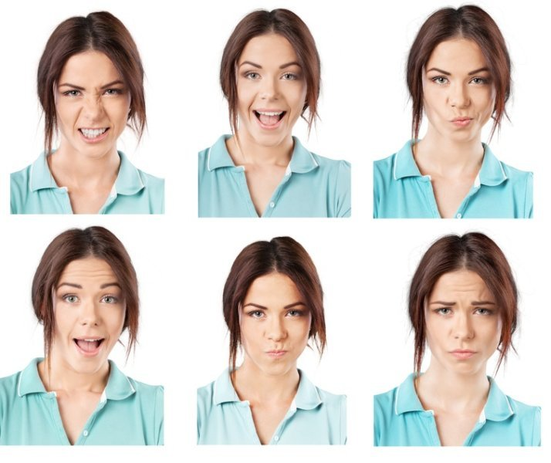
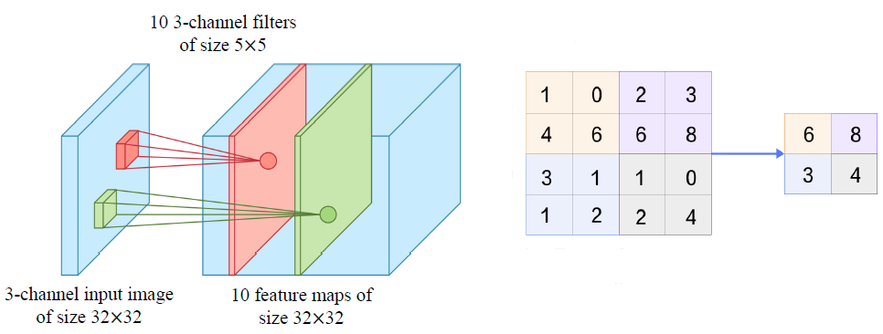
Literature review
Multi-level features for affective image analysis
High-level
(facial expression)
High-level (CNN)
Notes:
The existing methods mainly use two kinds of features. low-level features, element-of-art, such as saturation, brightness, colorfulness, color name, coarseness, contrast. Features based on theoretical and empirical concepts from psychology with art theory that are specific for affective analysis

Slide 12

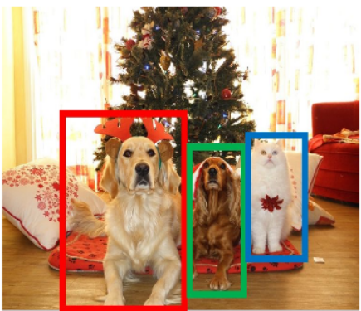
Literature review
Convolutional Neural Network (CNN)
Success in many computer vision tasks
Image Classification
Cat
what
Dog
Object Detection
what and where
Cat
Dog
…

Slide 13
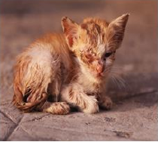

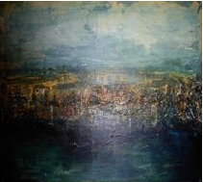
Literature review
Datasets
Small scale dataset
IAPS dataset
Art photo
Abstract
395 images
Emotion mainly evoked by emotional objects
May belong to several categories
806 photos
Combine emotional objects and visual characteristics
228 abstract paintings
Emotions decided by visual characteristics
Categories decided by 14 different people
Sad
Sad
Sad
Notes:
International Affective Picture System (IAPS) is a standard stimulus image set which has been widely used in emotion classification. IAPS consists of 1,182 natural color images depicting complex scenes, such as portraits, babies, animals, landscapes, pollution, illness and so on. Among all images Mikels selected 395 images and mapped them to eight discrete emotion categories. Artistic dataset (Art photo), 806 photos are selected from some art sharing sites using the names at emotion categories as search terms, The artists, who take the photos and upload them to web sites, determine emotion categories of the photos. Abstract dataset (280) represent emotion through overall color and texture, instead of some emotional objects. The emotional categories are obtained through a web-survey.

Slide 14
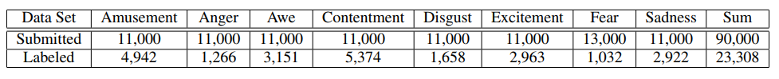
Literature review
Datasets
Large scale dataset
Contains 8 different emotion categories （Amusement, Awe, Anger, Contentment, Disgust, Excitement, Sadness）
90,000 images using category names as key works are downloaded from Instagram and Flickr (noise label)
23,308 images are selected after further labelling through AMT (well label)
Imbalanced dataset
Notes:
International Affective Picture System (IAPS) is a standard stimulus image set which has been widely used in emotion classification. IAPS consists of 1,182 natural color images depicting complex scenes, such as portraits, babies, animals, landscapes, pollution, illness and so on. Among all images Mikels selected 395 images and mapped them to eight discrete emotion categories. Artistic dataset (Art photo), 806 photos are selected from some art sharing sites using the names at emotion categories as search terms, The artists, who take the photos and upload them to web sites, determine emotion categories of the photos. Abstract dataset (280) represent emotion through overall color and texture, instead of some emotional objects. The emotional categories are obtained through a web-survey.

Slide 15
Outline
Introduction
Literature review
Methods and experiments
Conclusion and future work

Slide 16
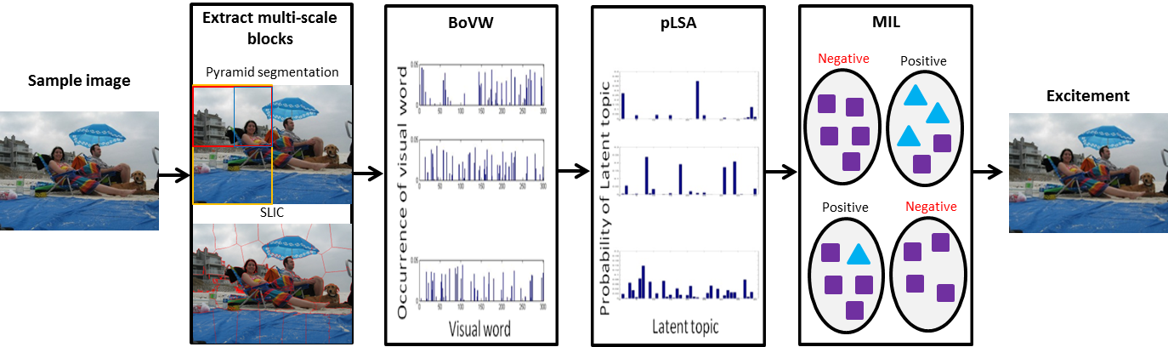
Methods and experiments
Region-based affective image analysis
Notes:
For the first problem, we extract multi-scale blocks to cover the different emotional regions in an image. Then, in order to bridge the gap between low-level features and high-level emotions, we introduce a mid-level representation, exploiting probabilistic latent semantic analysis (pLSA) to learn a set of mid-level representations as a set of latent topics from affective images. Finally, we employ multiple instance learning (MIL), based on the multi-scale blocks extracted from an image, to reduce the need for ‘exact’ labelling. The advantage of MIL is that it can instead learn from so-called ’weak’ labels.

Slide 17
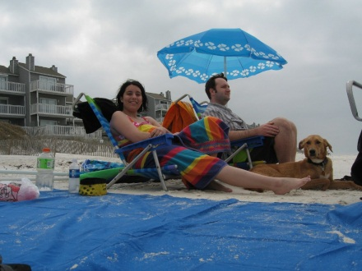





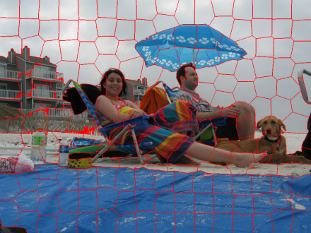

Region-based affective image analysis
Extracted multi-scale blocks
Pyramid segmentation
5 level: (2^(2*(i-1)))
Level 1
Level 2
Level 3
$$⋯$$
Simple linear iterative clustering(SLIC)
Similar block size
20
50
100
200
Notes:
To investigate the effect of different kinds of image blocks for emotion classification, we introduce two image segmentation methods. Pyramid segmentation in 6 level is too small to cover any emotional region. Compared to Pyramid segmentation, SLIC is very popular in recent years because it adheres to boundaries better than pervious methods. Use CIELab color space, L*: illumination; a*: position between red and green; b*: position between yellow and blue.

Slide 18
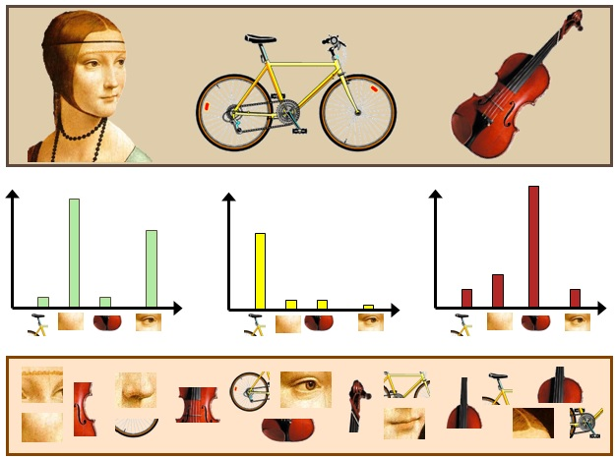
Region-based affective image analysis
Bag-of-Visual-Words (BoVW)
Notes:
Use BoVW to represent image blocks, use SIFT feature as basic features. 1. Extract features; 2. set up a Vocabulary; 3. compute the histogram of image

Slide 19
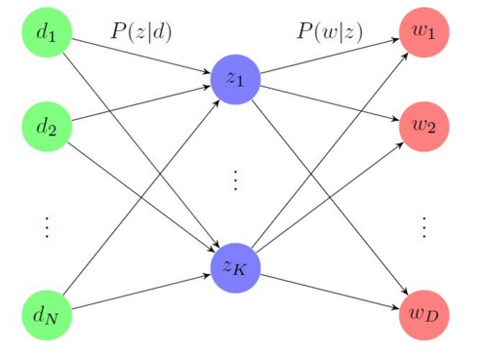
Region-based affective image analysis
Probabilistic latent semantic analysis (pLSA)
Mid-level representation to bridge affective gap
Words
Emotions
Topics
Notes:
For each image block, we further extract latent topics using pLSA. The pLSA model associates an unobserved class variable (latent topic). pLSA is very popular in image processing methods, such as scene detection.

Slide 20
Region-based affective image analysis
Multiple instance learning (MIL)
Positive instance
Negative instance
Negative bags
Positive bags
Notes:
An image may contain different remotion regions that can evoke different emotions. Ordinary classification methods can only classify the bags. Multiple instance learning (MIL) is a powerful method to deal with this kind of weakly labeled data.

Slide 21




Region-based affective image analysis
Training classifier
Excitement
68%
Awe
54%
Contentment
60%
Notes:
An iterative method is adapted to train the classifiers. At the initializing stage, all instances are classified by a naive Bayes classifier and positive instances are selected. Then, the selected instances are classified by a naive Bayes classifier with the classification result in last step as a prior and positive instances are chosen again. This process is repeated until no change happens when choosing the positive samples or the likelihood between bags and bag labels doesn't increase. At lase, we get the emotion classifier for the blocks.

Slide 22


































Region-based affective image analysis
Classification results
(a): SLIC (b): Pyramid segmentation
Sample image
Amusement
Anger
Awe
Disgust
Contentment
Excitement
Fear
Sad
(a)
(b)
(a)
(b)

Slide 23
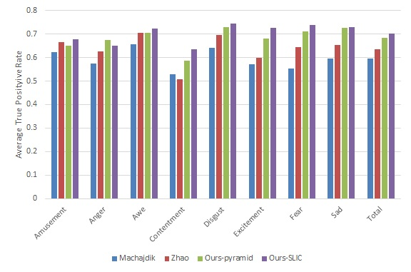
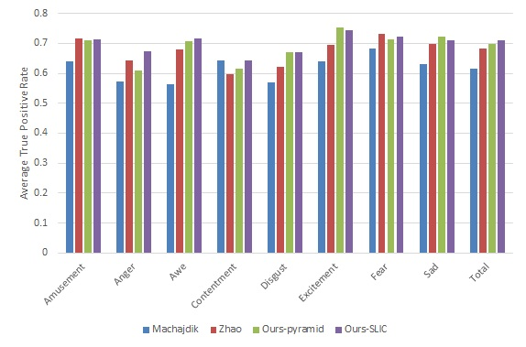
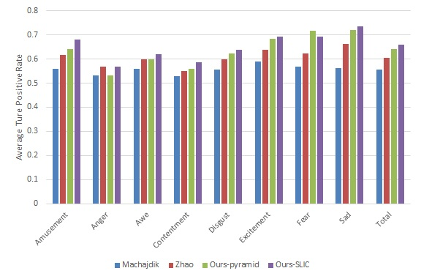
Region-based affective image analysis
Result of image emotion classification
4.9%
6.7%
3.6%
5.2%
IAPS
Art photo
1.5%
2.7%
Overall
3.4%
Overall
5.1%
Abstract
Notes:
Our method outperforms the other two methods and improves the classification accuracy for most of the emotion types, eliminates the effects brought by the regions with non-dominant emotion in an image compared to the features extracted from the whole image in existing methods.. Improvement of each dataset is unbalanced.

Slide 24
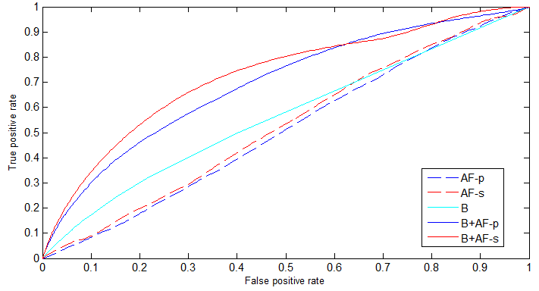
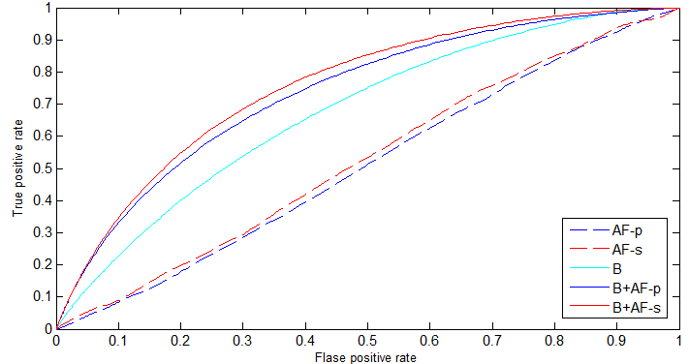
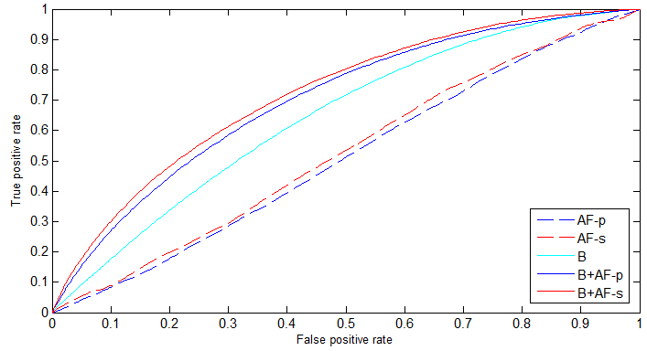
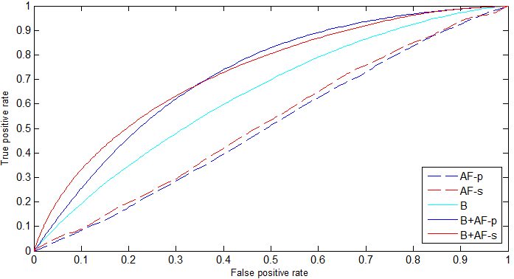
Region-based affective image analysis
Result of saliency detection
Itti
AIM
0.1201
0.1431
0.0687
0.0809
SUN
GBVS
0.0571
0.0755
0.0882
0.0897
AF-p: affective map based on pyramid segmentation; AF-s: affective map based on SLIC; B:baseline method; B+AF-p: baseline method with affective map based on pyramid segmentation; AF-s: baseline method with affective map based on SLIC
Notes:
Compared five result: 1. affective map based on pyramid segmentation only; 2.affective map based on SLIC only; 3.baseline method; 4.baseline method with affective map based on pyramid segmentation; 5.baseline method with affective map based on SLIC. Blue solid line and red solid line.

Slide 25
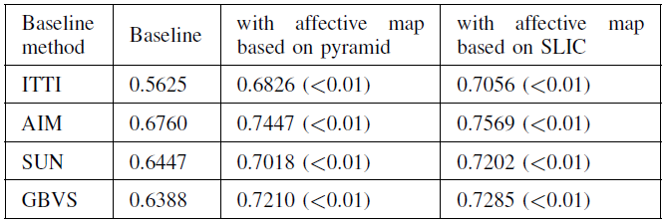
Region-based affective image analysis
Result of saliency detection
AUC of ROC curve
Notes:
Detailed data, AUC of ROC curve. Performance better in contrast-based method than information based method. Information affective emotions.

Slide 26




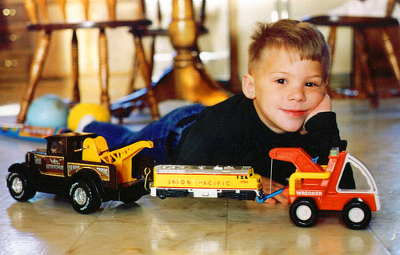

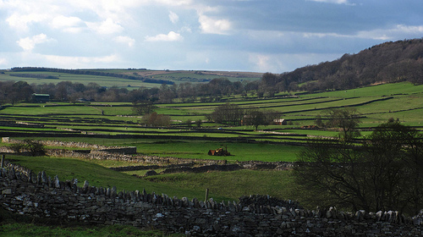

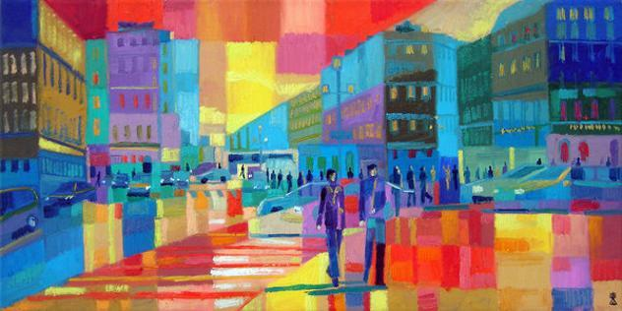
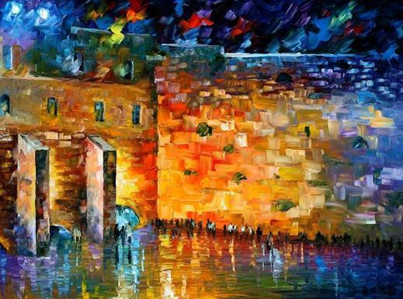
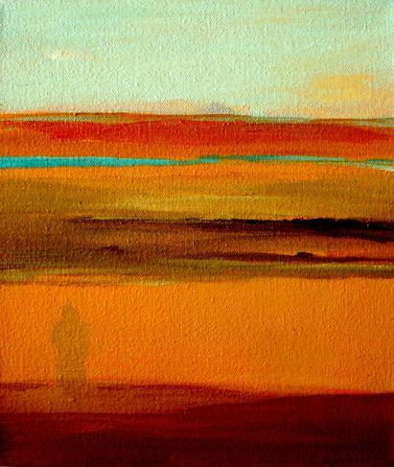


Methods and experiments
Deep Learning for Image Emotion Classification
Top 5 emotion classification result using AlexNet (Contentment)
(a) web images preferred high-level of image semantics
Amusement
Sad
(b) Abstract paintings preferred mid-level and low-level visual features
Correct result
Wrong result

Slide 27
Methods and experiments
Deep Learning for Image Emotion Classification
Different deep networks for various computer vision tasks
4096
4096
n
Image Recognition
(AlexNet)
4096
4096
N
c3
c4
c5
fc6
fc7
fc8
c2
c1
1000
256
n
Aesthetics Evaluation
Different number of convolutional layers
c3
c4
fc5
fc6
fc7
c2
c1
4096
4096
n
Texture Classification
energy3
fc4
fc5
fc6
c2
c1

Slide 28

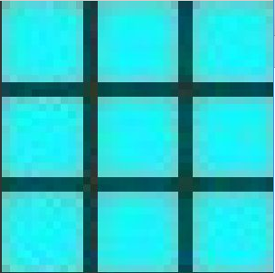
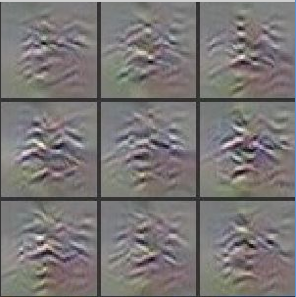
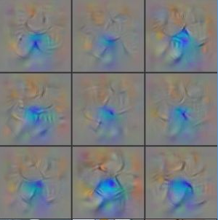
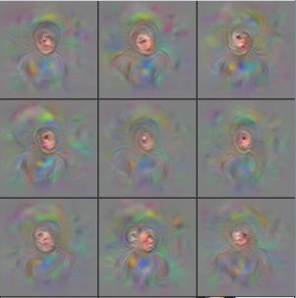
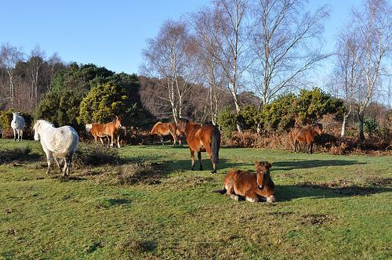
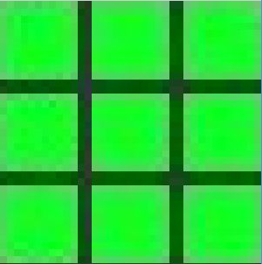
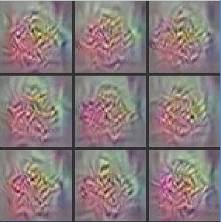
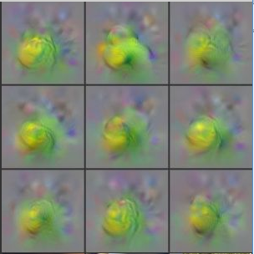
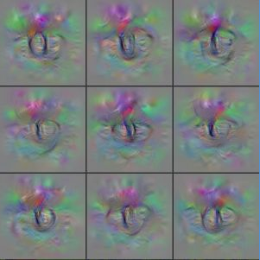
Methods and experiments
Deep Learning for Image Emotion Classification
Feature extracted from each convolutional layer
Image
Layer 1
Layer 2
Layer 3
Layer 4
color
texture
aesthetics
semantics
(face, horse leg)

Slide 29

Multi-level deep representations based method
Multi-level deep representations based method
11X11
128
1X1
128
3X3
128
5X5
256
1X1
256
3X3
256
5X5
384
1X1
384
3X3
384
5X5
512
1X1
512
3X3
512
Layer 1
Layer 2
Layer 3
Layer 4
Convolutional
Layer
1X1
128
1X1
128
1X1
128
1X1
128
Pooling
Layer
FC1_1
FC2_1
FC3_1
FC4_1
Fully Connected
Layer
FC1_2
FC2_2
FC3_2
FC4_2
Fusion Layer
Classification

Slide 30
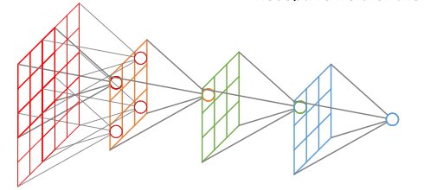
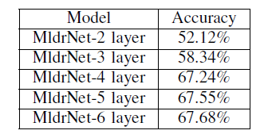
Multi-level Deep Representations based Method
Choice of Number of Layers in MldrNet
Receptive field changes for different convolutional layers
Accuracy for different MldrNet

Slide 31
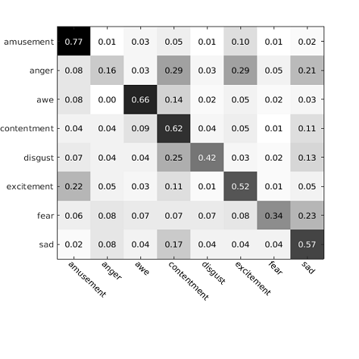
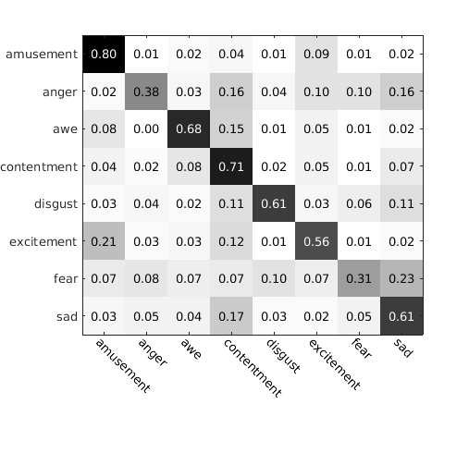
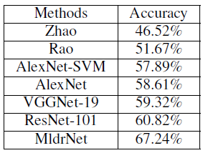
Multi-level deep representations based method
Results of image emotion classification
Large scale dataset
Accuracy
(a)
(b)
Confusion Matrix
(a): AlexNet (b): MldrNet

Slide 32
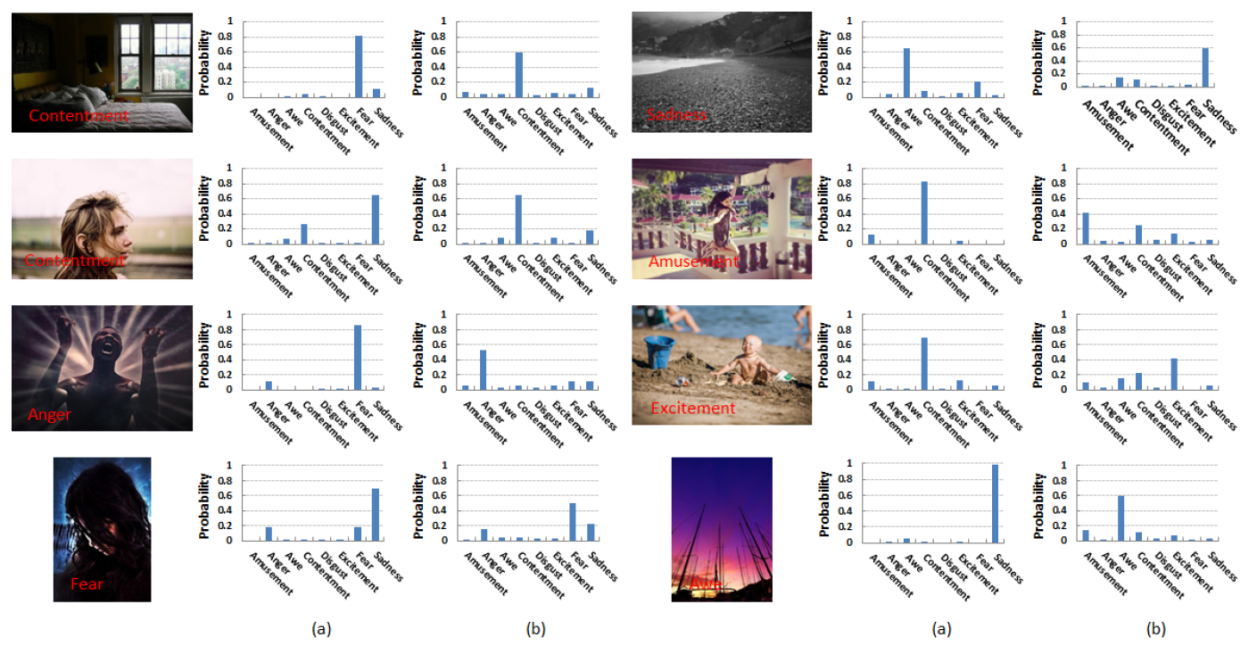
Multi-level Deep Representations based Method
Results of image emotion classification (deep learning feature)
(a): AlexNet (b):MldrNet

Slide 33
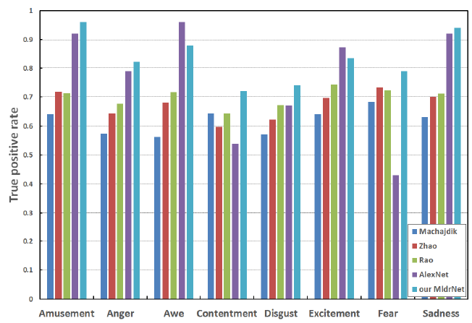
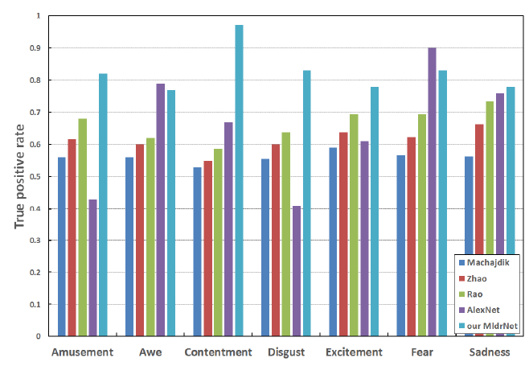

Multi-level deep representations based method
Results of image emotion classification
IAPS
Art Photo
Abstract

Slide 34
Multi-level deep representations based method
Further modification
11X11
128
1X1
128
3X3
128
5X5
256
1X1
256
3X3
256
5X5
384
1X1
384
3X3
384
5X5
512
1X1
512
3X3
512
Layer 1
Layer 2
Layer 3
Layer 4
Convolutional
Layer
1X1
128
1X1
128
1X1
128
1X1
128
Pooling
Layer
FC1_1
FC2_1
FC3_1
FC4_1
Fully Connected
Layer
FC1_2
FC2_2
FC3_2
FC4_2
GRU
GRU
GRU
GRU
Lower layer
Higher layer
GRU
GRU
Dependency
GRU
GRU
RNN with bi-direction GRU
Classification

Slide 35


Multi-level deep representations based method
Bi-direction GRU
Side brunch t
$$r_{t}=σ(W_{vr}V_{t}+W_{hr}h_{t−1}+b_{r})$$
$$z_{t}=σ\left(W_{vz}V_{t}+W_{hz}h_{t−1}+b_{z}\right)$$
$${\tilde{h}}_{t}=tanh⁡(W_{v\tilde{h}}V_{t}+W_{h\tilde{h}}(r_{t}⊙h_{t−1}+b_{\tilde{h}}))$$
$$h_{t}=z_{t}⊙h_{t−1}+(1−z_{t})⊙{\tilde{h}}_{t}$$
$V_{t}$ is the visual features extracted at side brunch $t$. $r_{t},z_{t},{\tilde{h}}_{t},h_{t }$are the reset gate, update gate, hidden candidate and hidden state. $W_{\left[∙\right][∙]}$is the weight matrix and $b_{[∙]}$ is bias term.

Slide 36


Multi-level deep representations based method
Results of image emotion classification (Bi-GRU)
Accuracy
(a)
(b)
Confusion Matrix
(a): MldrNet (b): MldrNet+Bi-GRU

Slide 37

Methods and experiments
Multi-level region-based convolutional neural network

Slide 38









Multi-level region-based CNN
Feature pyramid network
$$C_{2}$$
$$C_{3}$$
$$P_{3}$$
$$P_{2}$$
$$C_{4}$$
$$C_{5}$$
$$P_{5}$$
$$P_{4}$$
Conv1-5
1x1 conv
upsample 2x

Slide 39


Multi-level region-based CNN
Emotion distribution estimation
Anger
0.6
Triangle Distribution
Mikels’ emotion distance

Slide 40



Multi-level region-based CNN
Experimental validation
Emotional region detection

Slide 41


Multi-level region-based CNN
Experimental validation
Emotional region detection
Loss function

Slide 42

Multi-level region-based CNN
Result for image emotion classification

Slide 43
Outline
Introduction
Literature review
Methods and experiments
Conclusion and future work

Slide 44
Conclusion and future work
Contribution
Future work
Analysis different factors that effect image emotion classification
Collecting affective image datasets with more emotional information (emotional label, emotional region, emotional caption, etc.)
Integrating different level of features from both global and local view for image emotion classification
Weak supervised or unsupervised learning for image emotion classification
Considering uncertainty emotional label in affective image datasets
Multi-task learning for emotional labels and emotion distributions

